Slide 1
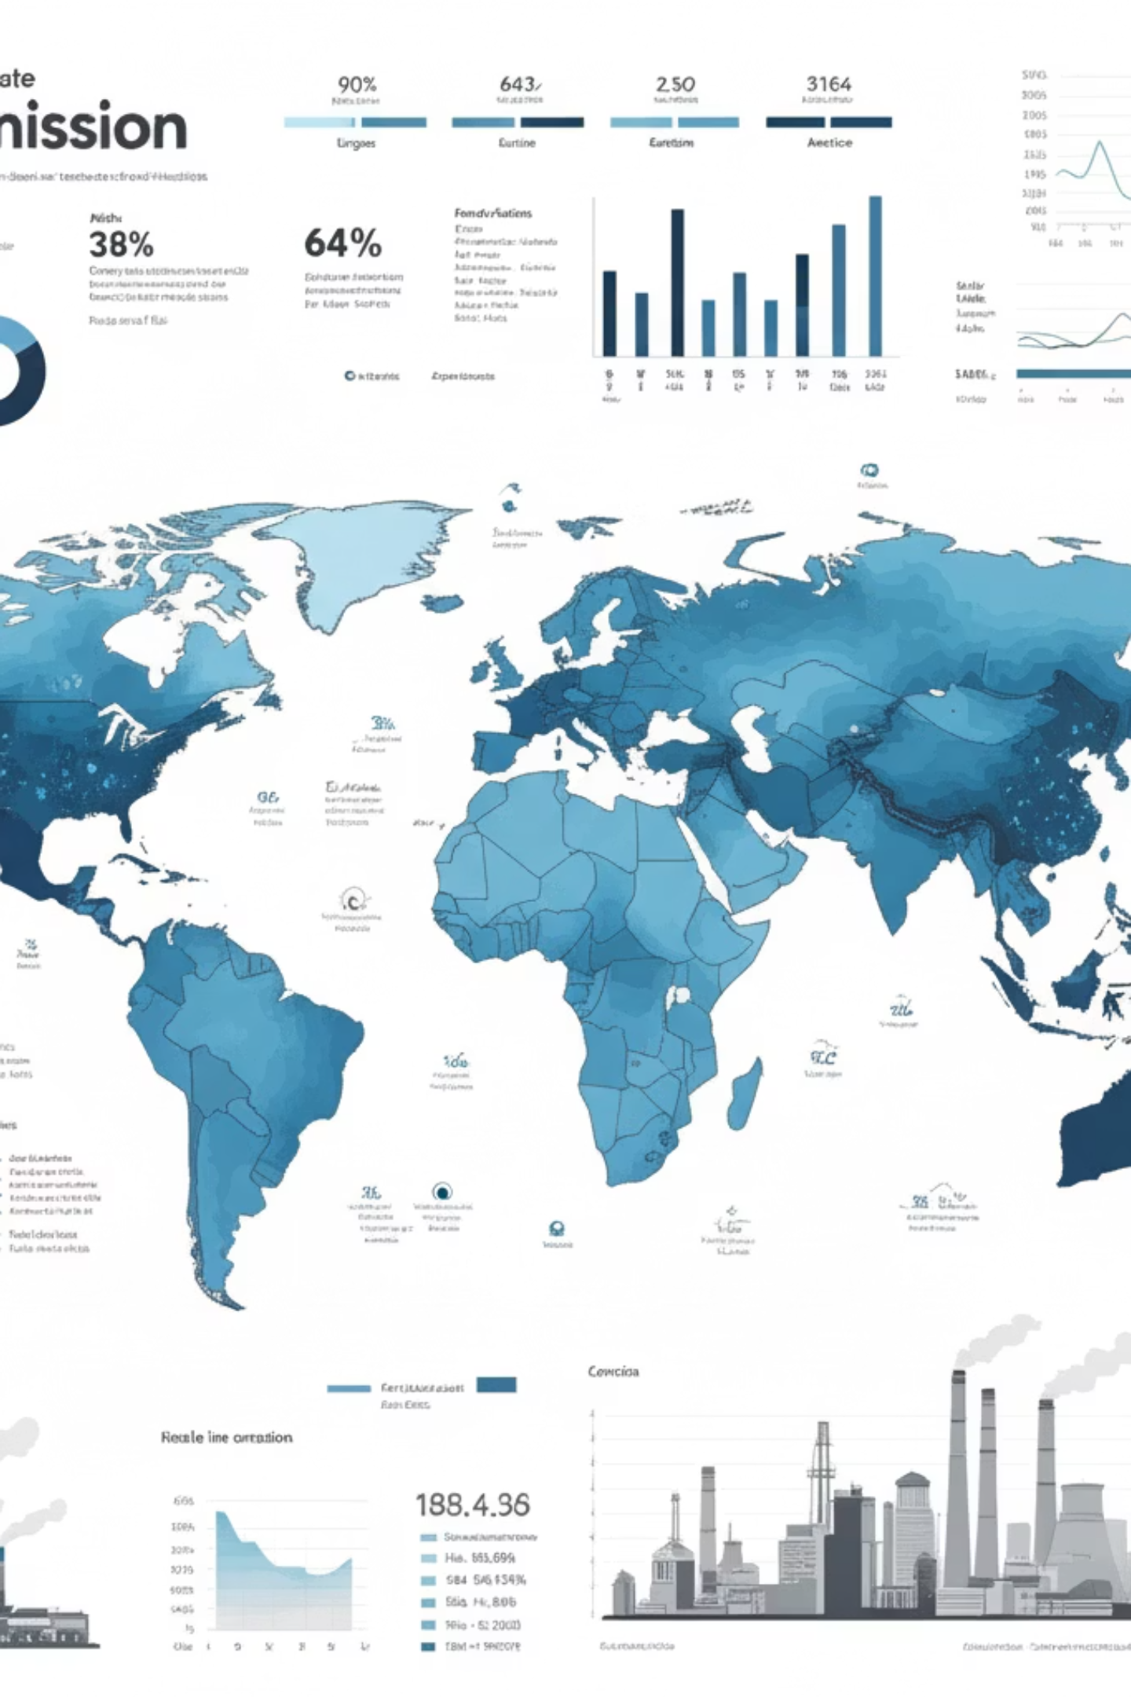
CO₂ Emissions Monitoring & Environmental Impact Analytics System
Presented by: Bhavani Myaka
Tools: Python | Databricks | Apache Airflow | Power BI

Slide 2

Business Context
Rising CO₂ emissions are a major driver of climate change
Environmental data is available but scattered and difficult to analyze
Manual analysis lacks scalability and consistency
Policymakers require reliable, data-driven insights for decision-making

Slide 3


Problem Statement:
CURRENT CHALLENGES:
THE NEED:
Environmental data exists but is fragmented and inconsistent
A scalable, automated analytics system
Converts raw emission data into policy-ready insights
Manual processing cannot scale for multi-year, multi-country analysis
Enables data-driven decision-making
No automated way to track emission trends
OUR SOLUTION:
No automated way to compare regions & sectors
Ingests raw CO₂ data from multiple sources
No automated way to evaluate climate policy impact
Cleans and standardizes it for consistency
Builds analytics-ready datasets
Automates execution with orchestration
Delivers interactive dashboards for stakeholders

Slide 4




Project Objectives: Clarity, Efficiency, Impact
Our aim is to build a robust, automated platform that delivers comprehensive CO₂ emission insights, empowering stakeholders with precise environmental intelligence.
Automate Data Ingestion
Centralize CO₂ Data
Streamline the collection and processing of diverse datasets.
Create a unified, accessible repository for all emission data.
Enable Advanced Analytics
Ensure Scalability & Reliability
Support sophisticated analysis for deeper environmental understanding.
Design a system capable of handling growing data volumes and demands.

Slide 5
Data Foundation & Dataset Overview
Dataset Overview
Key Columns
Source: Simulated real-world environmental dataset
country
Records: ~20,000
region
year
Granularity: Country × Year × Sector
sector
population
gdp_billion_usd
co2_emissions (Million Metric Tons)
scenario (Baseline, High Growth, Policy Reduction, Renewable Transition)

Slide 6
Comprehensive Data Scope
Our system integrates a wide array of parameters to offer a holistic view of global CO₂ emissions and their environmental drivers.
Geographic
Temporal
Sectoral
Global coverage, focusing on key emitting countries.
Historical data spanning multiple decades to current year.
Detailed breakdown by industry, energy, transport, and agriculture.
Socio-Economic
Scenario Analysis
Correlation with population, GDP, and economic indicators.
Integration of future emission projections and policy impacts.

Slide 7


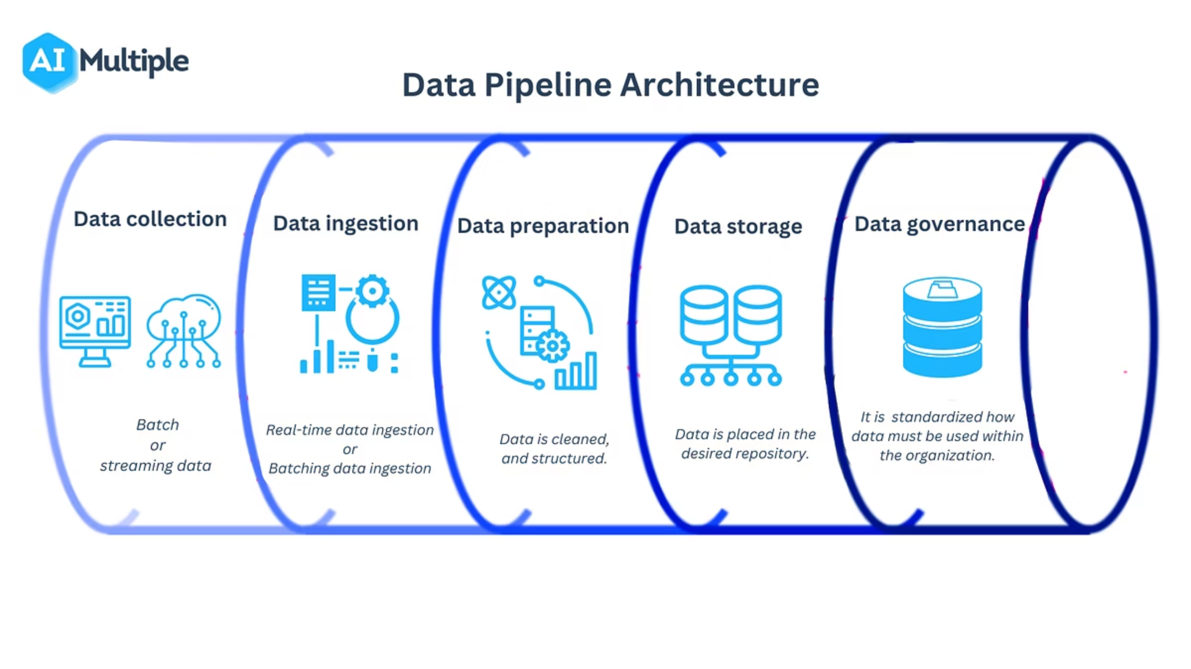
End-to-End System Architecture
A seamless flow from raw data ingestion to insightful visualizations, ensuring data integrity and timely delivery of intelligence.
Multiple Data Sources
Logs, APIs, DBs, files
Analytics & Dashboards
Data Lake
End-to-End Data Flow
Reports and visual insights
Central raw data storage
Data Warehouse
ETL / Data Processing
Modeled, query-ready data
Cleanse, transform, enrich

Slide 8

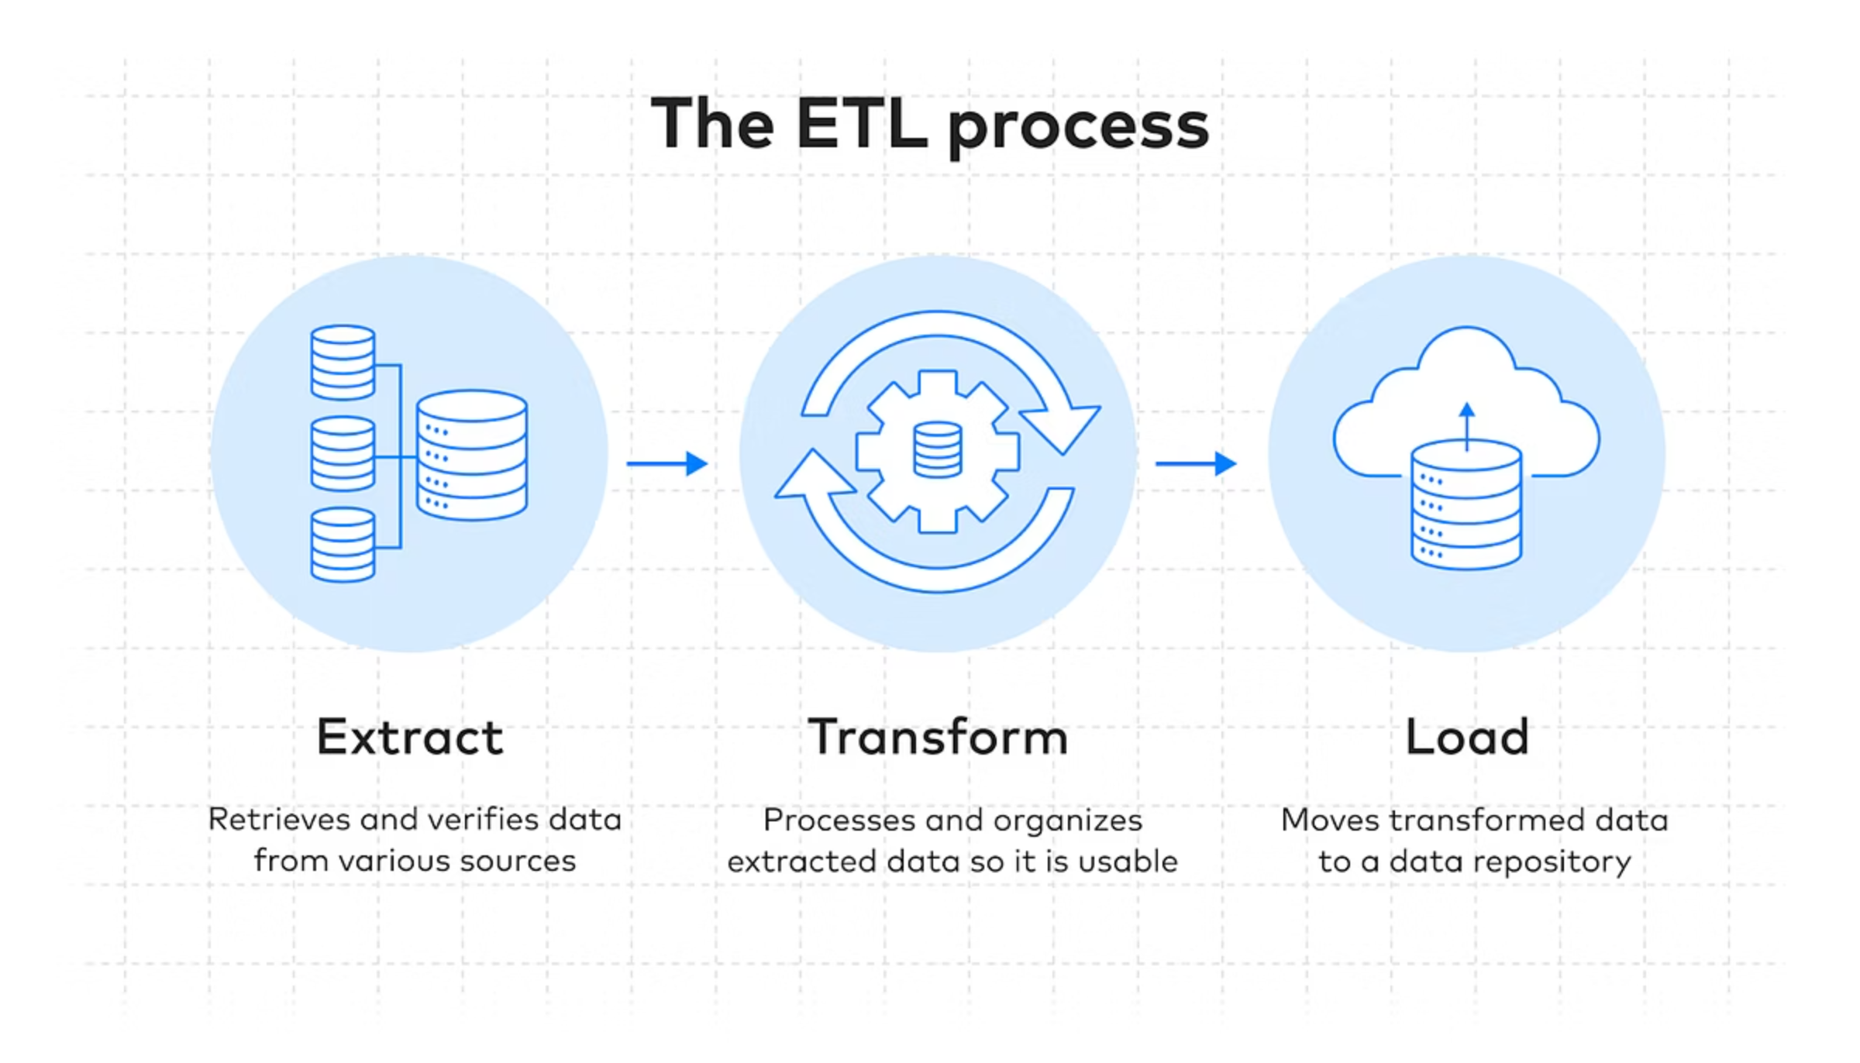



ETL Pipeline: Bronze, Silver, Gold Layers
Our structured ETL process ensures data quality, transformation, and accessibility for various analytical needs.
Bronze Layer
Raw, untransformed data from source systems.
Silver Layer
Cleaned, standardized, and conformed data.
Gold Layer
Aggregated, business-ready data for reporting.

Slide 9
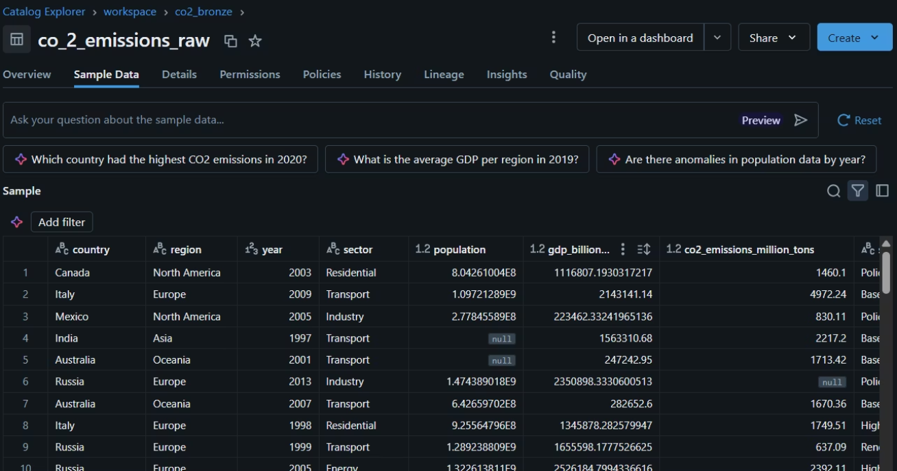
Bronze Layer — Raw Data Ingestion
Foundation of our data pipeline: Preserving original data integrity
WHAT WE DID:
Uploaded dataset into Databricks
Stored raw data without modification
Validated schema, numeric columns, and year format
KEY VALIDATIONS:
Schema validation (column names, data types)
Numeric columns verification
Year format consistency check
PURPOSE:
Maintain data traceability
Preserve original records
Enable audit trail for data lineage

Slide 10
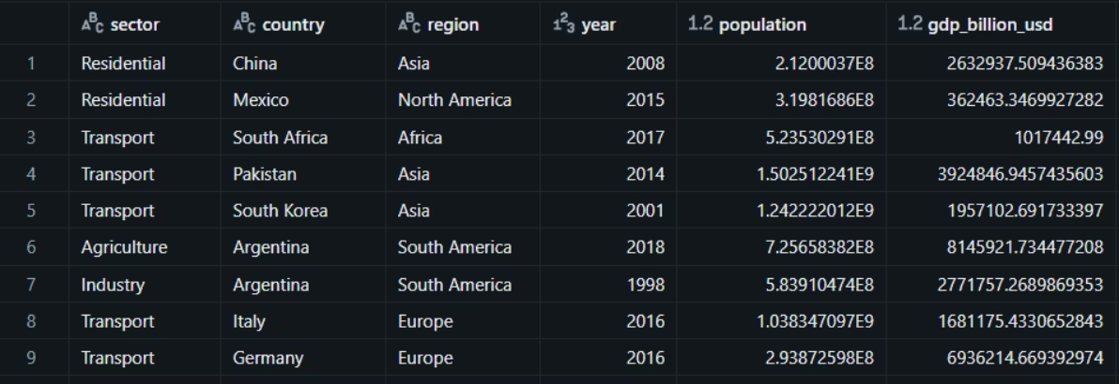
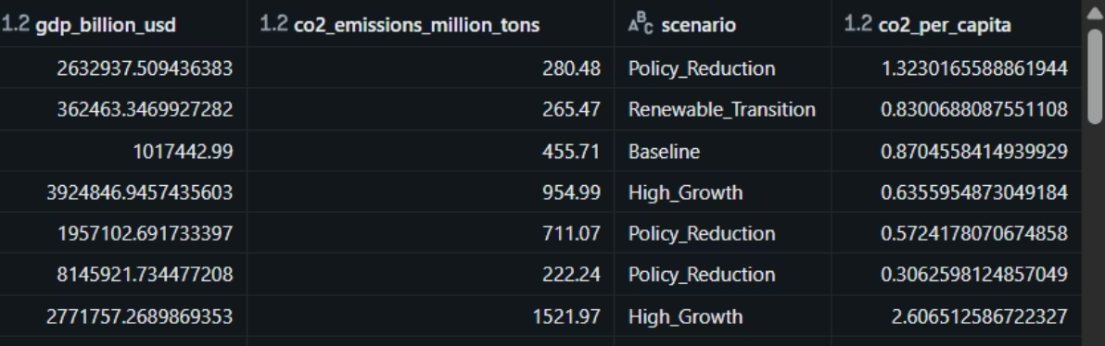
Silver Layer — Data Cleaning & Transformation
Standardizing and enriching data for analytics readiness
CLEANING STEPS:
Handled missing values in Population, GDP, and CO₂ emissions
Removed duplicates across all records
Standardized country names for consistency
Standardized region labels
Standardized year formats
DERIVED METRICS:
CO₂ per capita (co2_per_capita = total_emissions / population)
GDP per capita metrics
Emission intensity calculations
PURPOSE:
Ensure data quality and consistency
Create analytics-ready datasets
Enable meaningful comparisons across regions and time periods

Slide 11
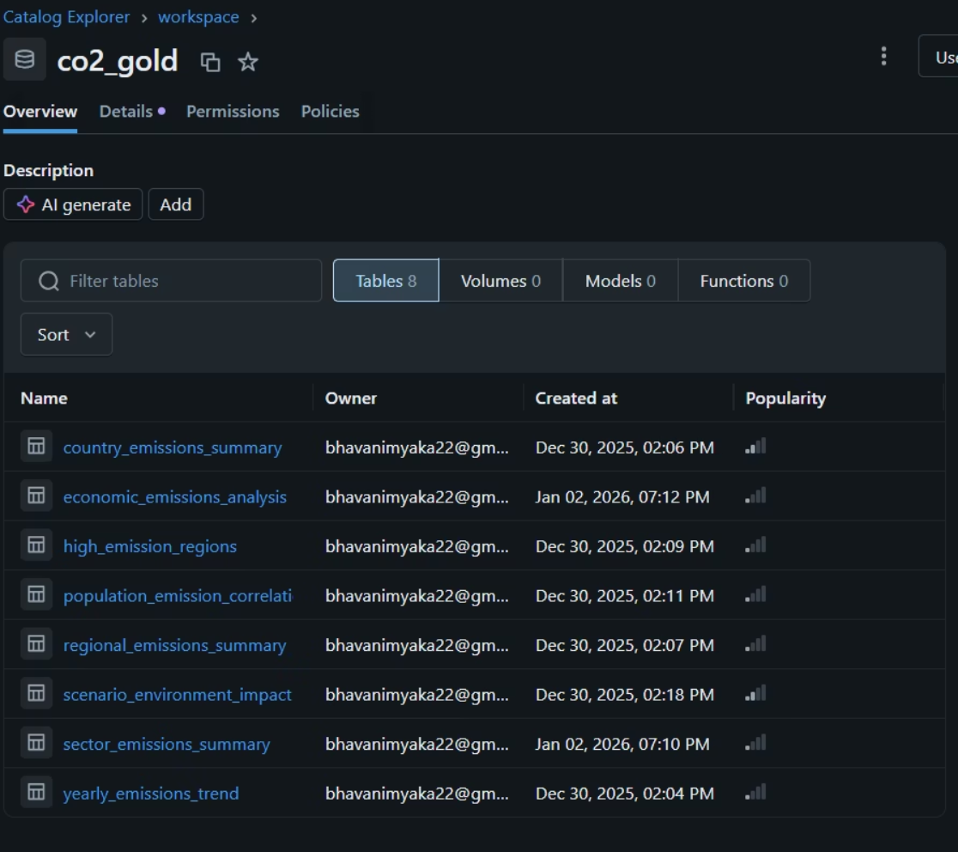
Gold Layer — Analytics Tables & Business-Ready Data
Curated datasets designed for specific analytical and policy questions
ANALYTICS TABLES CREATED:
yearly_emissions_trend (temporal analysis)
regional_emissions_summary (geographic insights)
country_emissions_summary (country-level metrics)
sector_emissions_summary (sectoral breakdown)
high_emission_regions (top emitters identification)
population_emission_correlation (demographic relationships)
economic_emissions_analysis (GDP and emissions linkage)
scenario_environment_impact (policy scenario outcomes)
PURPOSE:
Each table answers a specific environmental or policy question
Enable direct dashboard integration
Support advanced analytics and forecasting
Facilitate scenario-based decision making

Slide 12
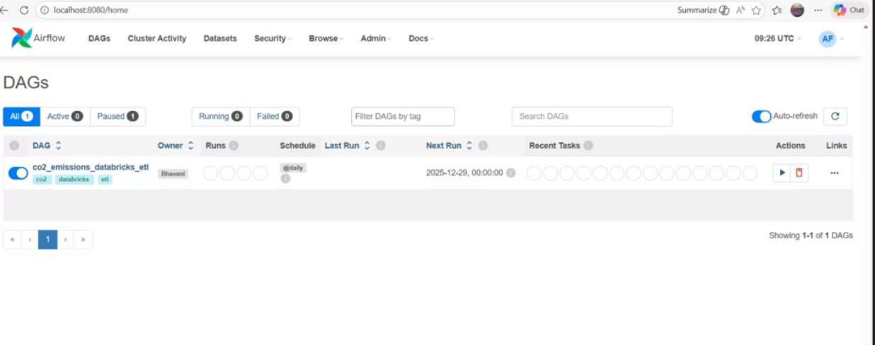
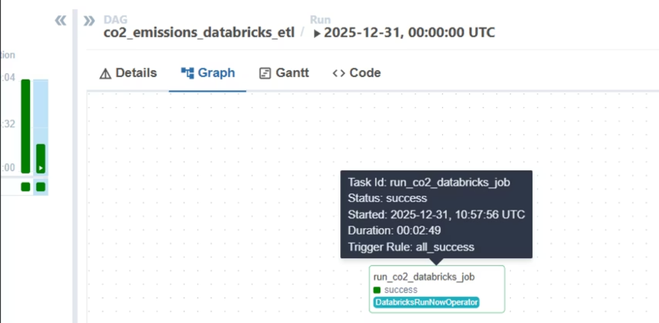
Workflow Automation with Apache Airflow:
Airflow orchestrates our complex data pipelines, ensuring reliability, scalability, and maintainability of our CO₂ analytics system.
Scheduled data extraction and loading
Dependency management for tasks
Error handling and retry mechanisms
Monitoring of pipeline health and performance

Slide 13
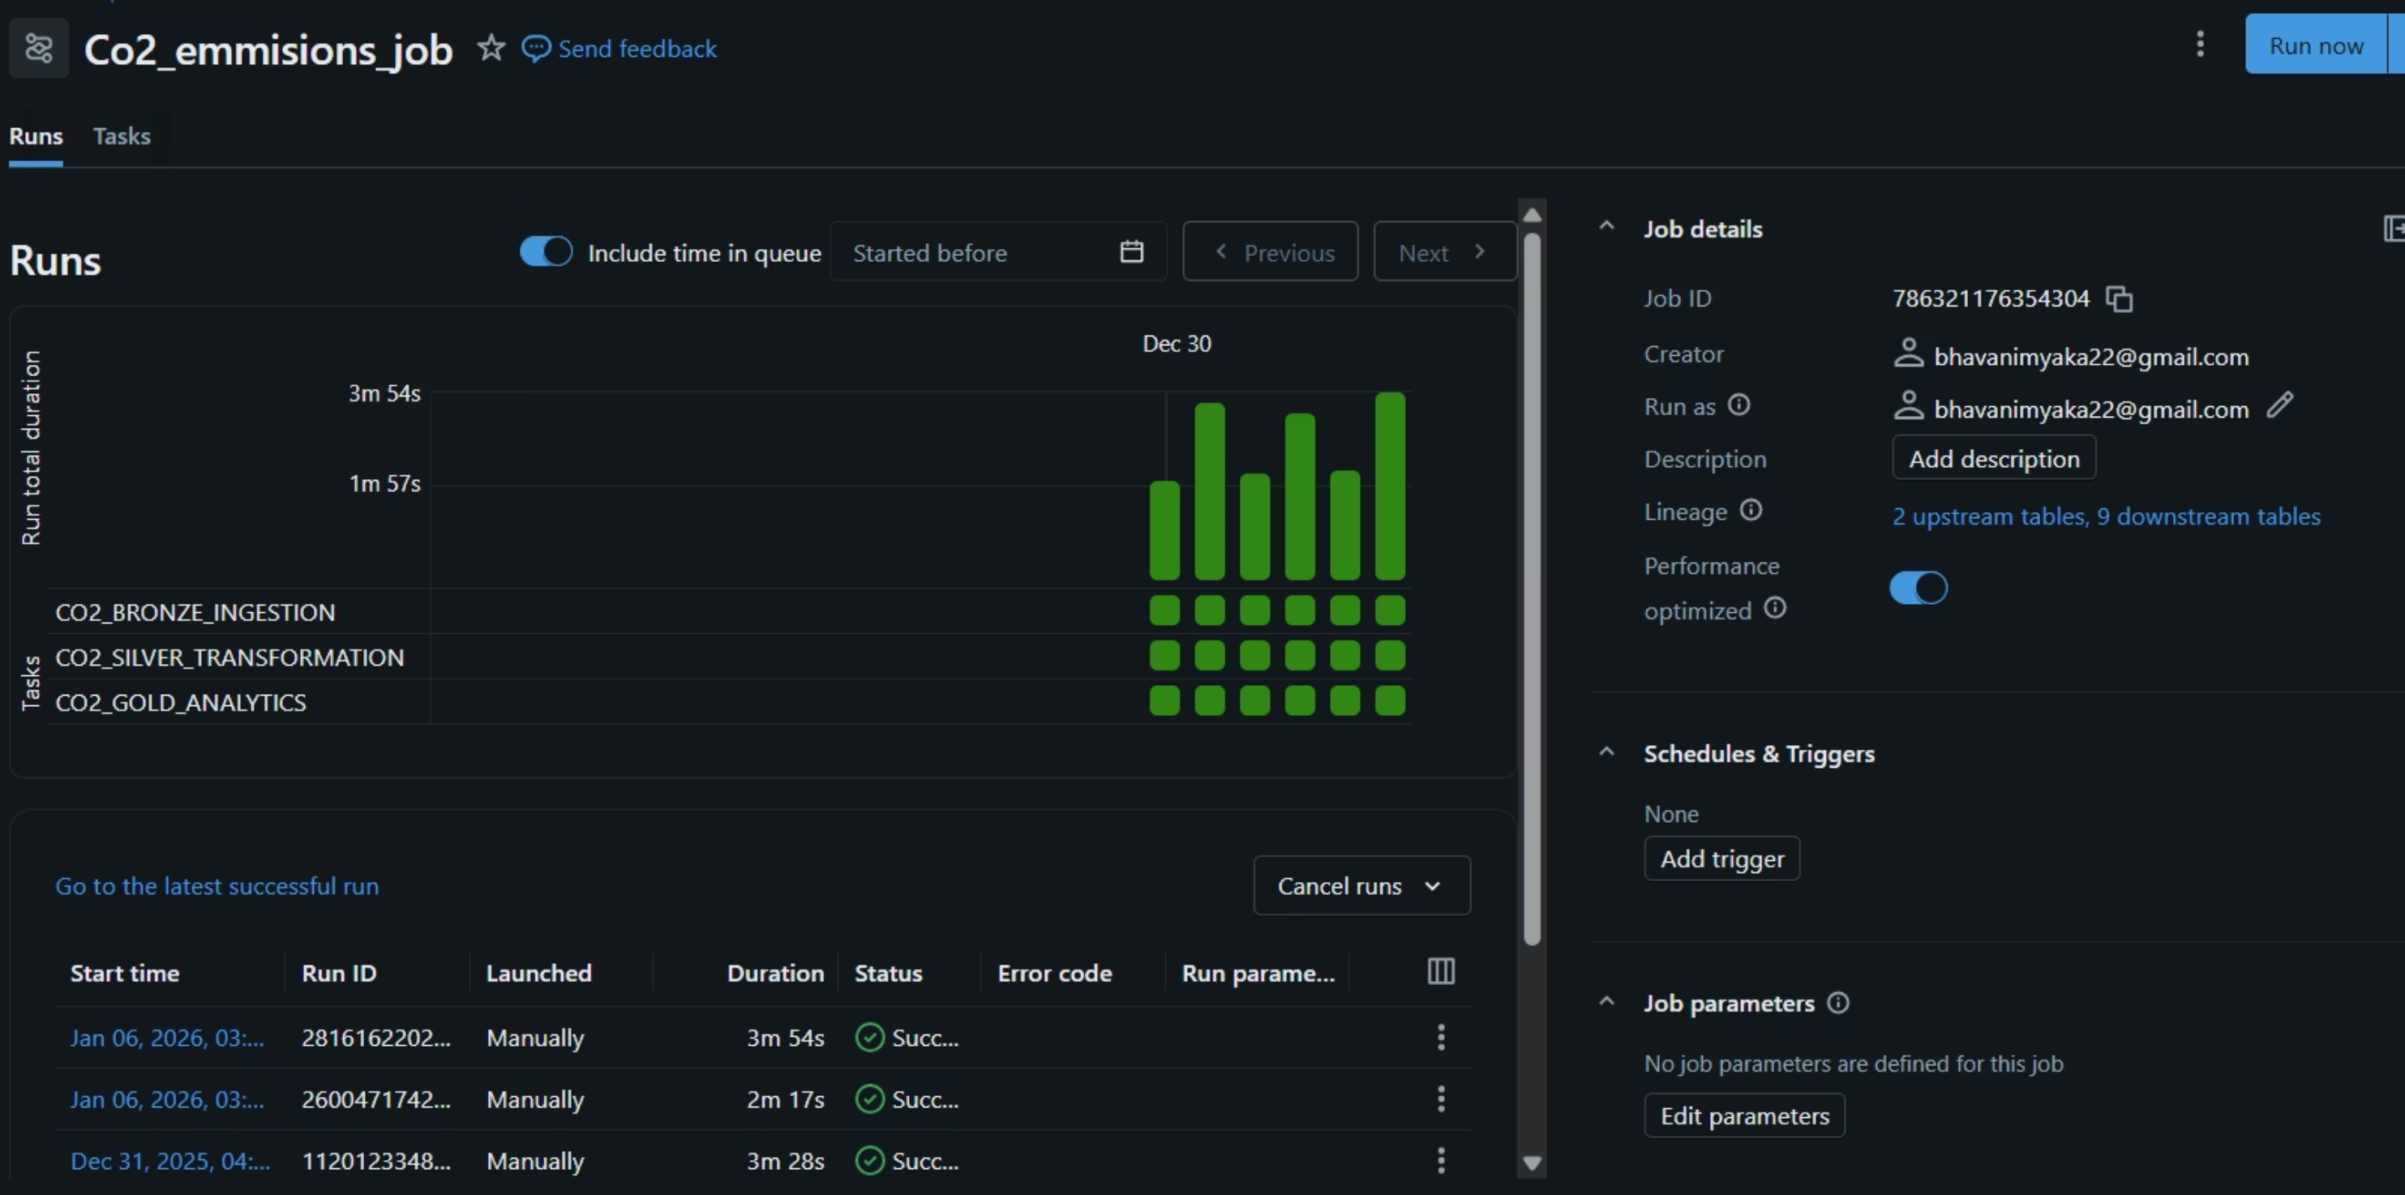

Succesful ETL Pipeline JobRun

Slide 14
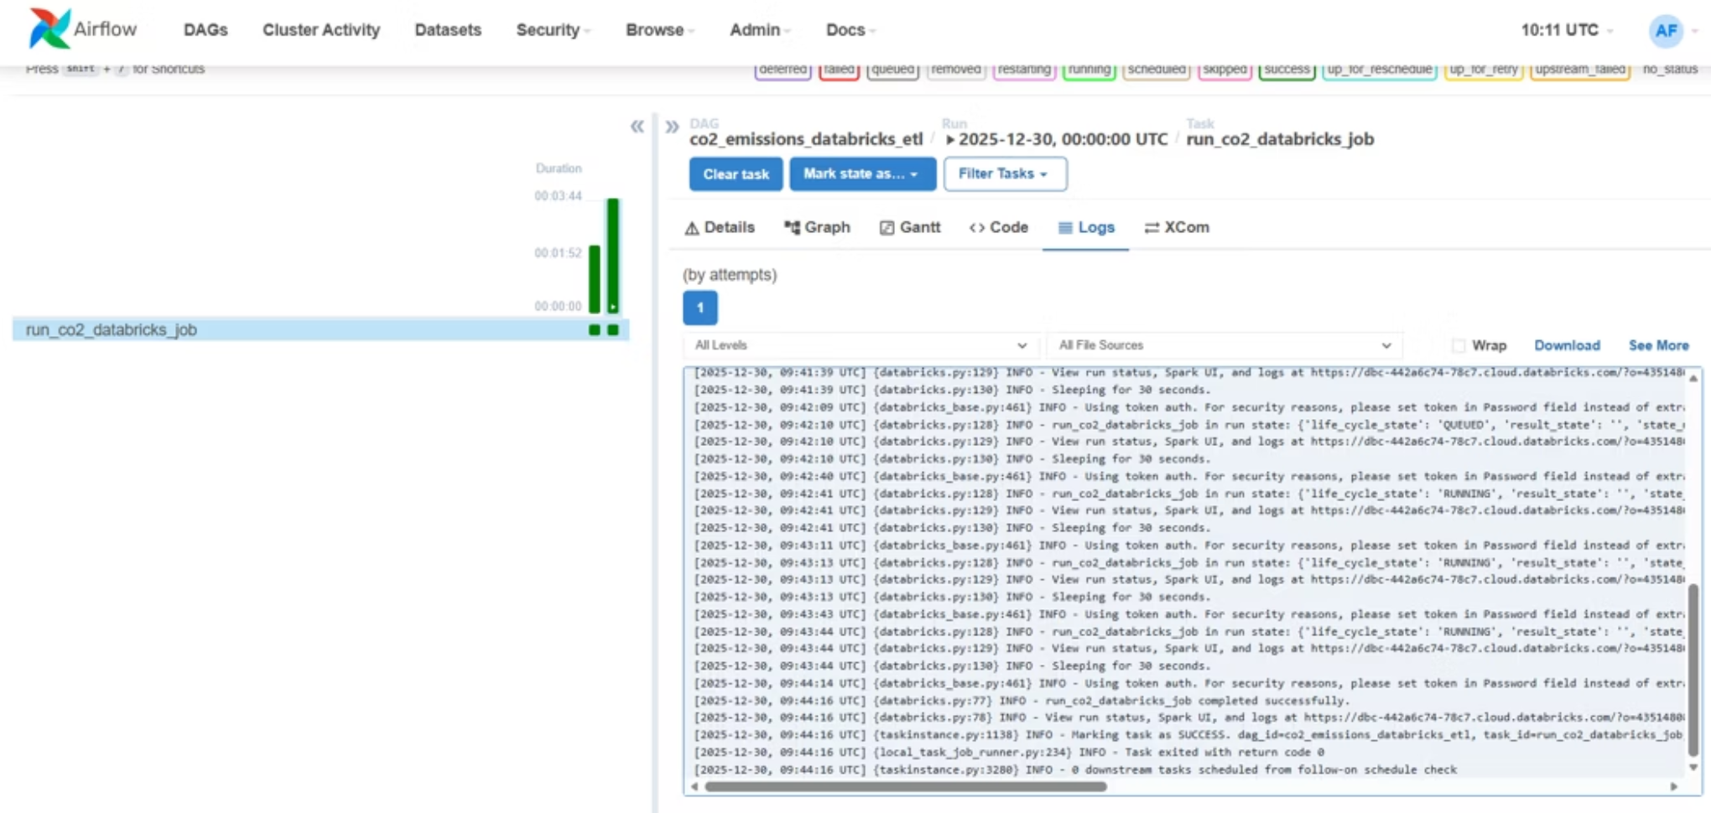
Logging & Monitoring
Airflow
Databricks
DAG execution status
Job run logs
Task-level logs
Spark UI for performance monitoring
Retry and failure tracking
Custom pipeline execution log table

Slide 15
Power BI Dashboards
Main Dashboards
Features
Executive CO₂ emissions overview
Interactive slicers and Filters
Time-series trend analysis
Drill-down and cross-filtering
Regional, country, and sector comparison
AI visuals ( Key Influencers)
Scenario-based policy impact dashboards

Slide 16
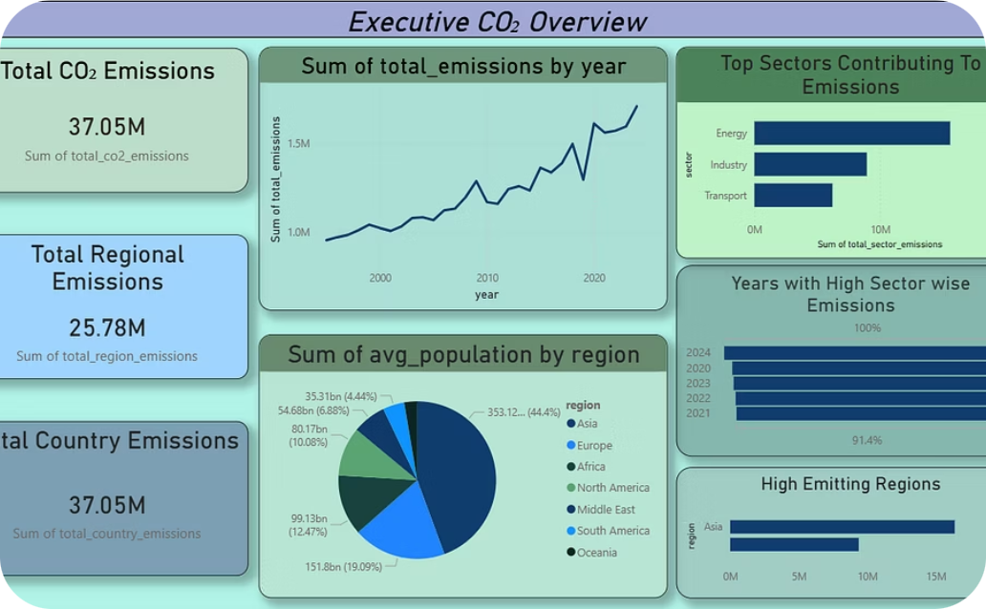
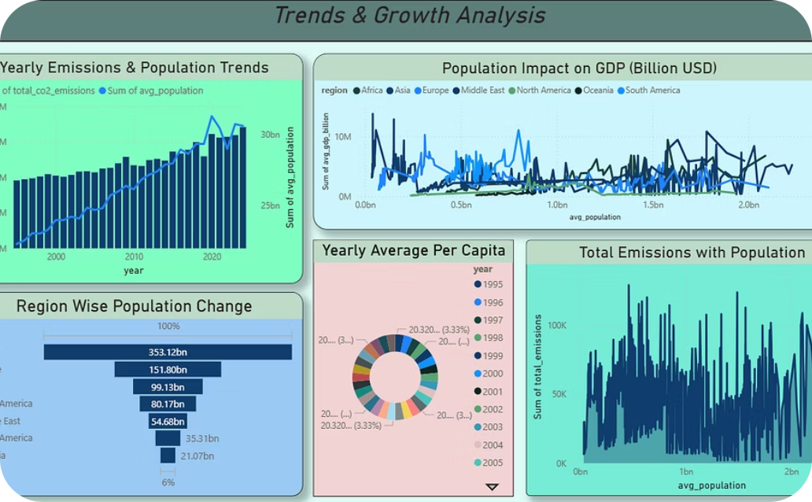
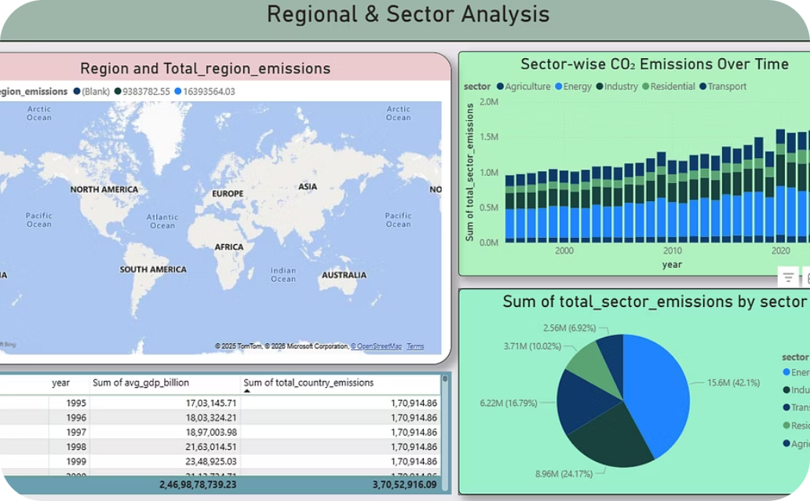
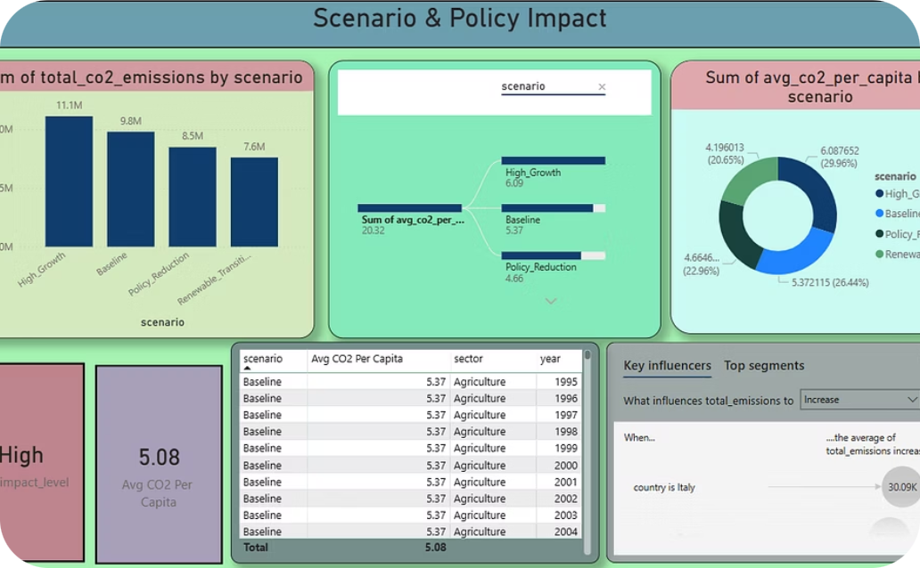
Dashboard Showcase: 4 Key Dashboards
Interactive visualizations for comprehensive CO₂ emissions analysis
Executive Overview Dashboard
Trend Analysis Dashboard
Regional & Sector Wise Comparison Dashboard
Policy Impact Dashboard

Slide 17
Analytics Implemented: Environmental & Economic Insights
TREND ANALYSIS
REGIONAL COMPARISON
SECTOR ANALYSIS
Year-over-year emission growth tracking
Asia, Europe, North America dominance analysis
Energy & Industry as major contributors
Long-term trend identification across decades
Regional emission contribution percentages
Sectoral breakdown and comparison
Emission intensity by sector
Growth rate calculations and projections
Geographic hotspot identification
ECONOMIC IMPACT
POPULATION IMPACT
SCENARIO IMPACT
GDP vs Emissions correlation analysis
Emissions per capita calculations
Policy vs High Growth outcomes comparison
Population growth vs emission relationships
Economic development and environmental trade-offs
Emission reduction potential assessment
Demographic analysis of environmental burden
Cost-benefit analysis of emissions
Policy effectiveness evaluation

Slide 18
Key Insights from CO₂ Emissions Analytics
1
Global CO₂ emissions exhibit a consistent long-term upward trend, increasing from ~1.0M MtCO₂ in the mid-1990s to over ~1.7M MtCO₂ in recent years, indicating sustained environmental pressure despite regional policy efforts.
2
Asia emerges as the highest emitting region, contributing the largest share of total regional emissions, followed by Europe and North America, highlighting the impact of rapid population growth and industrial expansion.
3
Energy and Industry sectors are the dominant contributors, together accounting for more than 65% of total sector-wise emissions, making them the primary targets for emission reduction strategies.
4
Population growth shows a strong positive relationship with emissions, as regions with higher average population levels consistently report higher total emissions, reinforcing the importance of per-capita metrics in environmental assessment.
5
Economic growth correlates with increased emissions, where higher GDP regions demonstrate elevated CO₂ output, indicating a trade-off between economic development and environmental sustainability.
6
Scenario-based analysis reveals meaningful emission reduction potential, with Policy Reduction and Renewable Transition scenarios showing 20–30% lower total emissions compared to the High Growth scenario.
7
Per-capita emissions decrease under policy-driven scenarios, confirming that strategic interventions can decouple population growth from emission intensity.

Slide 19

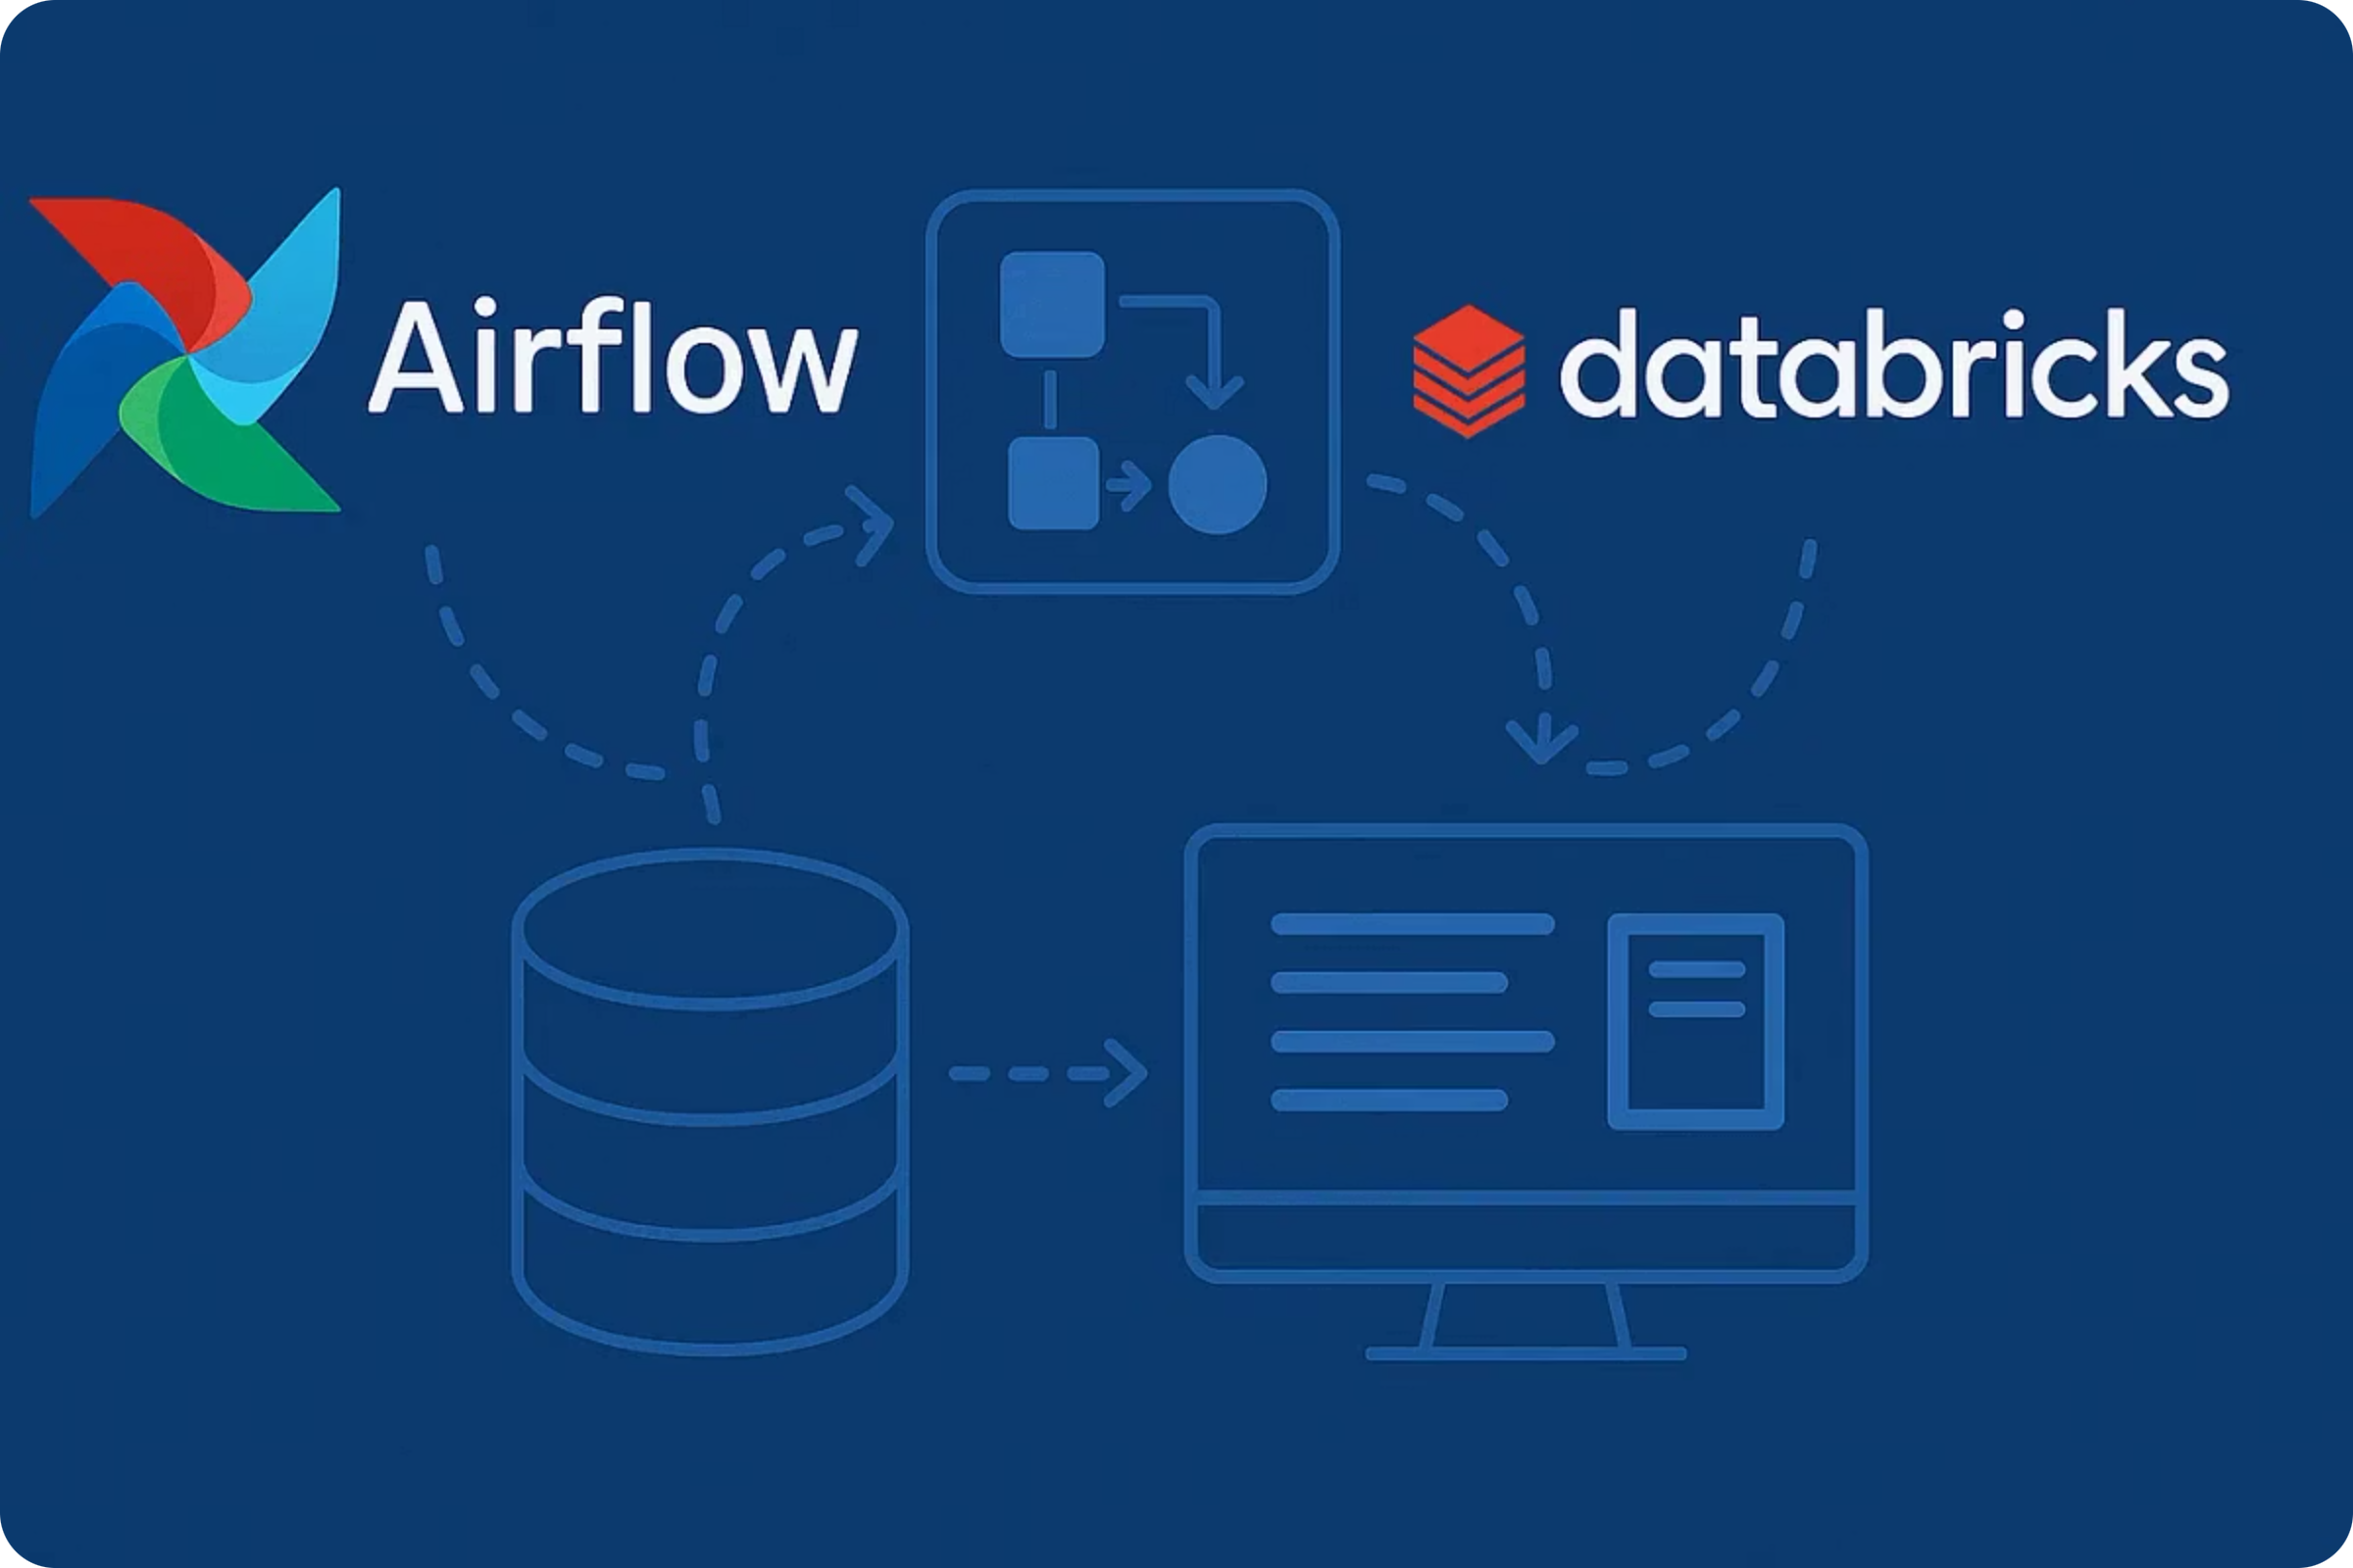
Robust Technology Stack
Leveraging industry-leading tools, our platform is built for performance, scalability, and advanced analytical capabilities.
Data Processing
Python
PySpark
Big Data & Automation
Databricks
Delta Lake
Apache Airflow
Visualization
Power BI

Slide 20
Conclusion & Future Scope
Conclusion
Future Scope
Built a complete end-to-end environmental analytics system
Real-time data ingestion
Predictive ML-based emission forecasting
Scalable, automated, and monitored data pipeline
Automated alerts for policymakers
Enables data-driven environmental decision-making

Slide 21
Thank You

